Slide 1
AI-BASED IMAGE GENERATION USING STABLE DIFFUSION
CREATING REALISTIC CORPORATE-THEMED IMAGES WITH TEXT PROMPTS
Submitted by: Satrughan Kumar

Slide 2
🎯 PROJECT OBJECTIVE
To generate a realistic image of a professional man named Cyfuture confidently standing in front of a modern corporate building using Stable Diffusion.

Slide 3
🧰 TECHNOLOGIES & TOOLS USED
- Google Colab
- Stable Diffusion v2
- Hugging Face Diffusers
- PyTorch
- CUDA (optional)

Slide 4
📜 PROMPT USED
“A man named Cyfuture, dressed sharply, confidently standing in front of a modern corporate building with the logo Cyfuture displayed above the entrance.”

Slide 5
🧑‍💻 IMPLEMENTATION STEPS
1. Install Libraries using pip
2. Load model using StableDiffusionPipeline
3. Prompt-based image generation
4. Save image with image.save()

Slide 6
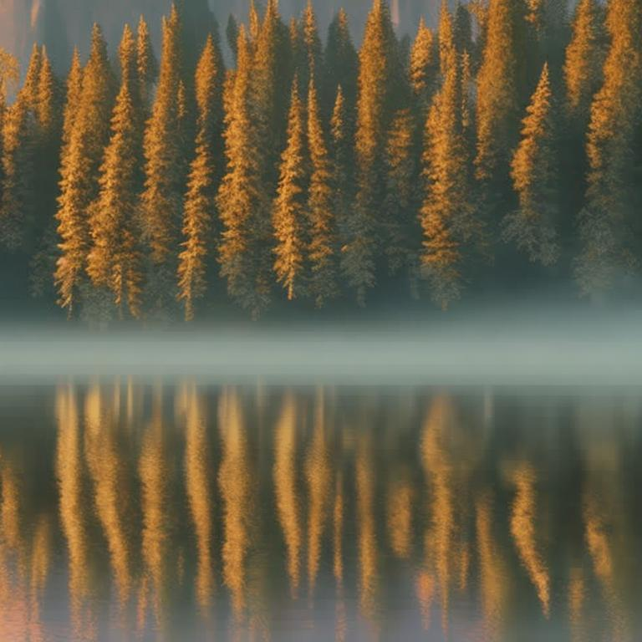
🖼️ GENERATED OUTPUT

Slide 7
🌟 APPLICATIONS
- Brand concept visuals
- Corporate illustration
- Marketing mockups

Slide 8
🔚 CONCLUSION
- Text-to-image models offer creative freedom
- Easy to deploy with Colab + Hugging Face
- Explore prompt tuning and further customization

